Slide 1
IoT Data Analytics Transformation
Tapping data from legacy systems to utilize predictive analytics solutions

Slide 2

Martin John Madsen, Ph.D.
Senior Data Analytics Consultant
15+ years’ experience working with data gathering, analysis, and predictive analytics

Slide 3
HCL Global IoT Report 2017
“50% think that their organization is already behind the curve on IoT”
https://www.hcltech.com/iot-survey

Slide 4
HCL Global IoT Report 2017
“What benefits would you expect your organization to see if it were able to increase its utilization of IoT?”
https://www.hcltech.com/iot-survey

Slide 5
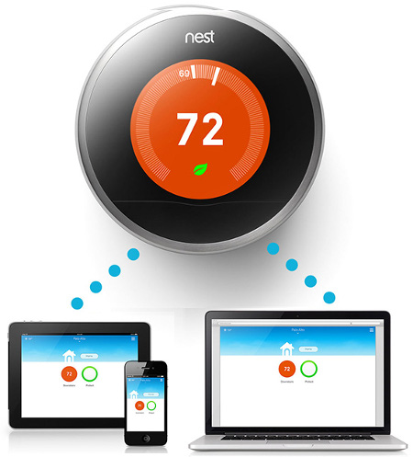

Future of IoT?
http://linuxgizmos.com/google-acquires-nest-gains-linux-based-iot-tech/
http://dulitha.me/iot/2014/06/03/internet-of-things-and-device-management/

Slide 6
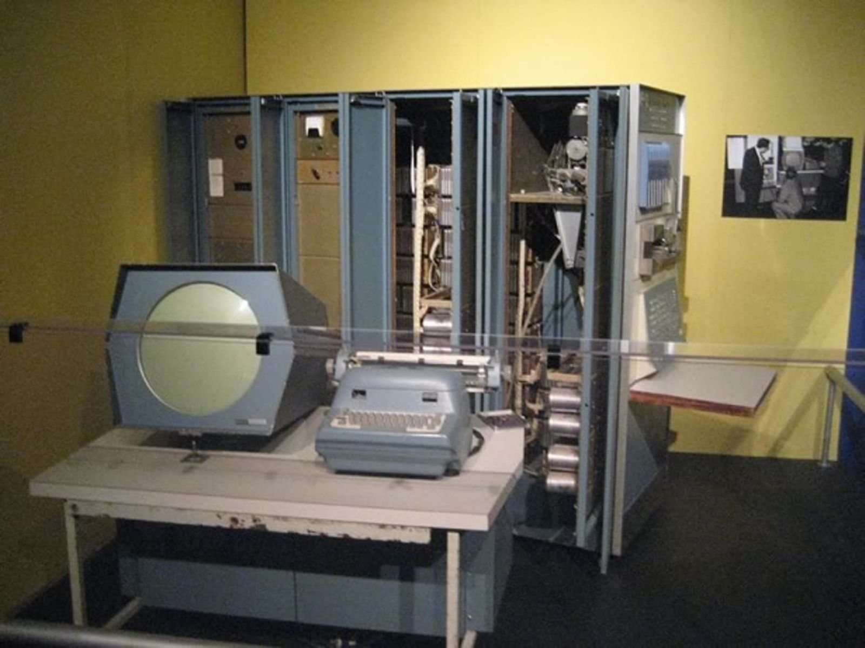
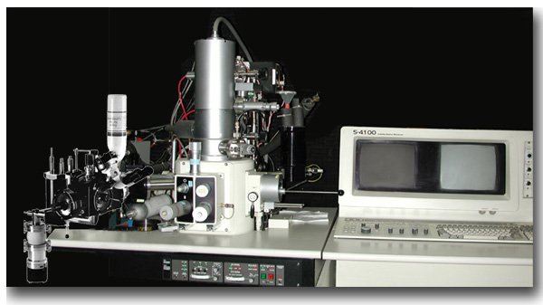
Future of IoT
Increased organizational efficiency
Improved use of data to drive insights
Opportunities to move up and down the value chain
Better communication between business departments
DATA
http://www.popularmechanics.com/culture/gaming/
a20129/the-very-first-video-game/
DATA
https://sgil.ba.ars.usda.gov/snowsite/4100/4100.html

Slide 7





Data Analytics Maturity Model
ACCESS
Current-state process mapping
Future-state process definition
Data mapping
Process & Data Mapping
HIGH
INSIGHT
Standard reporting and dashboards
Ad-hoc reporting
Analysis/query/drill-down
Descriptive Analytics
BUSINESS VALUE
FORESIGHT
Data mining, Monte-Carlo simulation
Pattern recognition and alerts
Forecasting, Predictive modeling
Predictive Analytics
AGILITY
Optimization
Stochastic optimization
LOW
Prescriptive Analytics
Process & Data Mapping
Descriptive Analytics
Predictive Analytics
Prescriptive Analytics
BASIC
SKILLS
ADVANCED

Slide 8
Predominant customer Value perception
Municipal Water Meters IoT
HIGH
BUSINESS VALUE
LOW
https://www.sas.com/en_us/whitepapers/iot-analytics-in-practice-107941.html
Process & Data Mapping
Descriptive Analytics
Predictive Analytics
Prescriptive Analytics
BASIC
SKILLS
ADVANCED

Slide 9








IIoT Roi Example Components
Cost Estimates
Savings Estimates
Administration
Network
Labor
Downtime
Technical Support
Time-to-Release
Inspection
Price

Slide 10


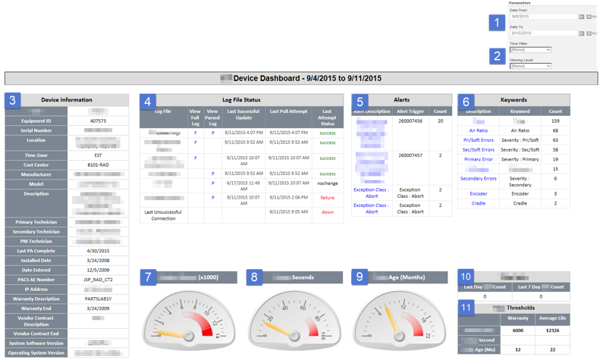
PREDICTIVE MACHINE MAINTENANCE
Medxcel technicians are responsible for providing maintenance to imaging devices in their hospital clients. At best the process was reactive and required manual diagnostics before the repair could begin. Medxcel was searching for a means to become proactive in their service offering.
SOLUTION
Allegient provided Medxcel with a dashboard utilizing SSRS. The dashboard provides the overall device health and alerts technicians of any machine failures. The solution parsed semi-structured log data into useful chucks that would be visualized on the dashboard.
RESULTS
Medxcel is now able to parse through the machine logs and visualize the status of each machine they manage. As a result, Medxcel is able to identify key issues before they arise. Medxcel is looking to move to a true predictive solution that will forecast potential machine issues before they occur.

Slide 11
Use Case Demo

Slide 12
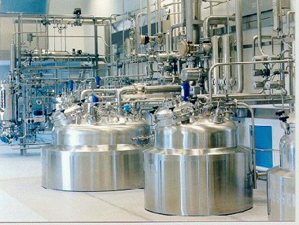
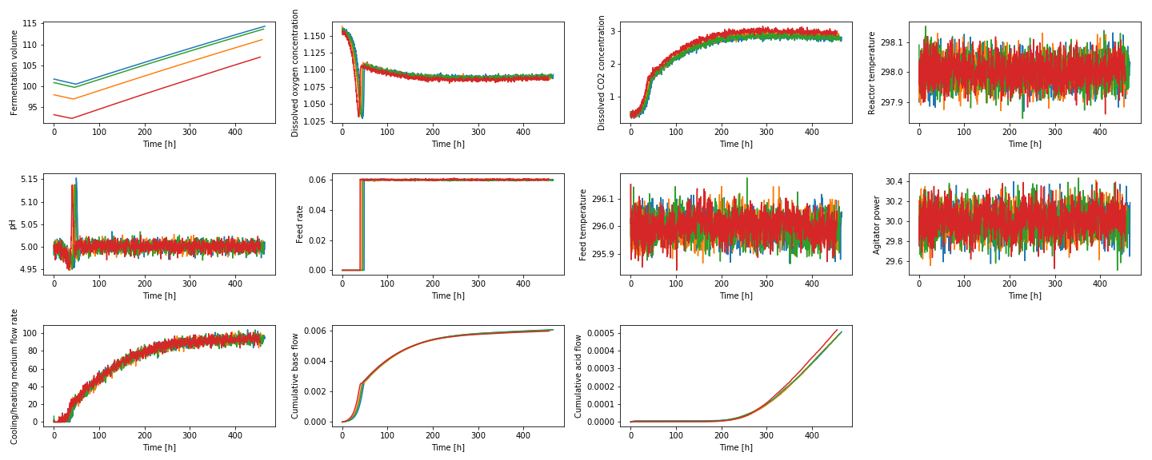
Business Use Case
(Fictional) Penicillin Manufacturer
KPI: Batch Quality

Slide 13
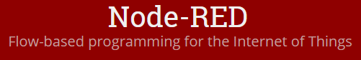
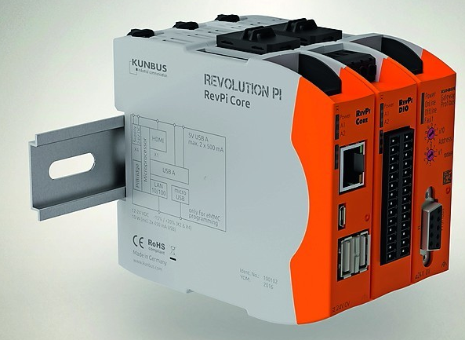

From Legacy System to Enterprise Data
IoT-Based
System Data Tap
https://revolution.kunbus.com/
http://www.businessinsider.com/google-data-centers-2014-10

Slide 14
Historical Batch Data Exploration

Slide 15
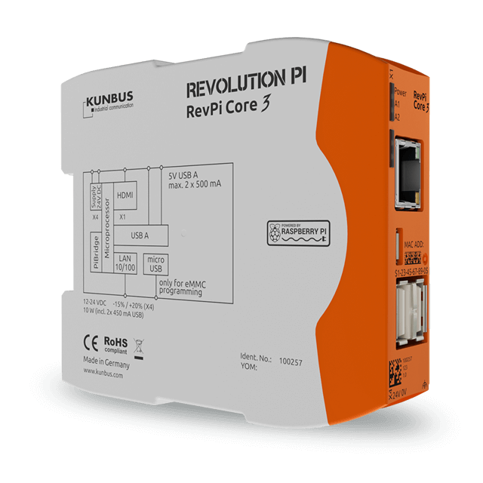



Azure IoT hub: Brining KPI DATA to the Cloud
SSL Security from the start
Azure IoT Hub
Azure Stream Analytics
Power BI
Dashboard

Slide 16

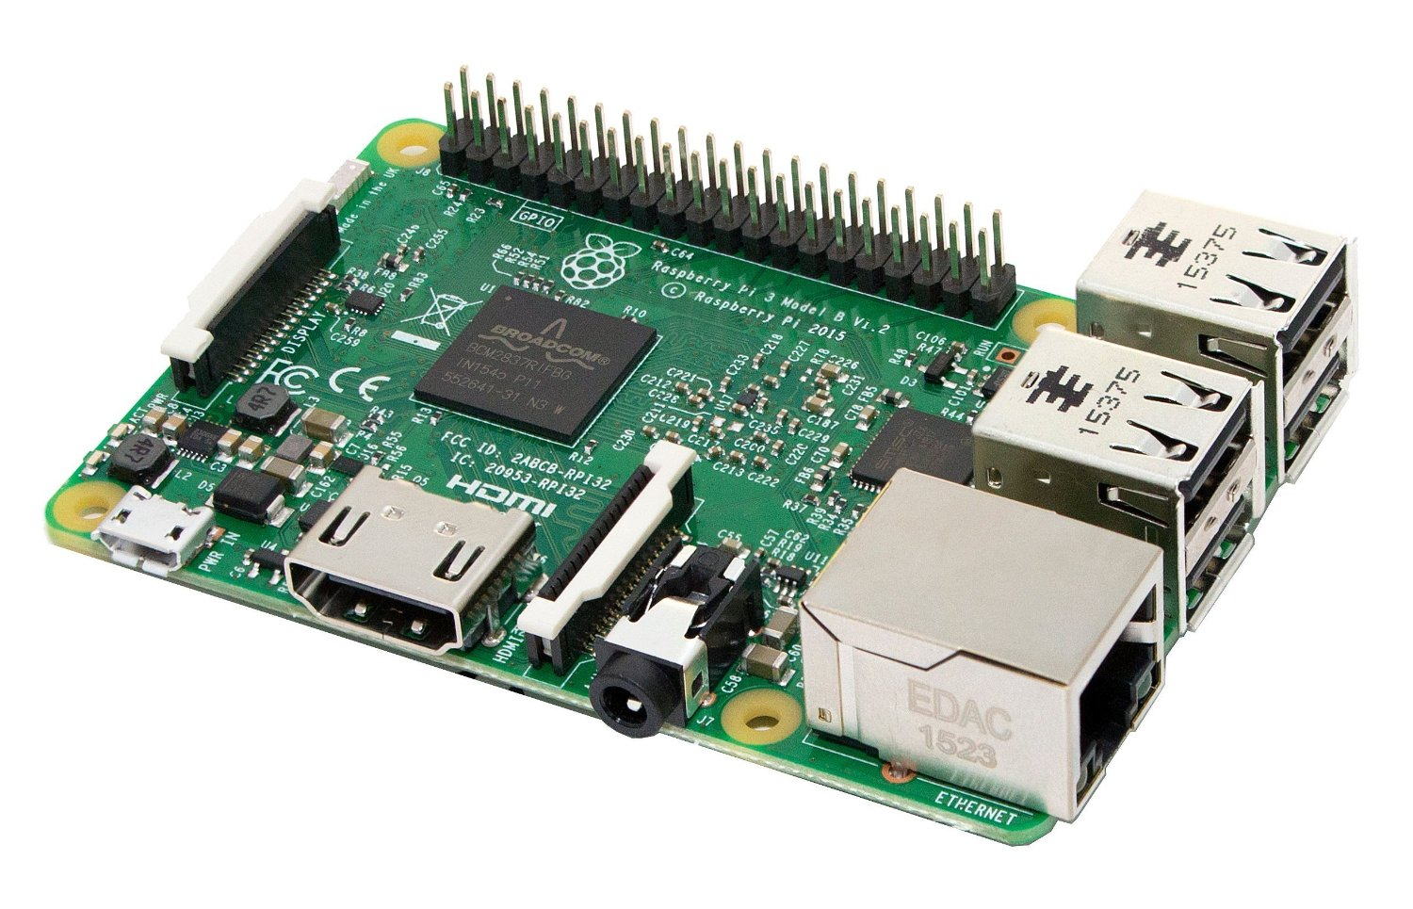

Work Flow Demo
Azure IoT Hub
Azure Stream Analytics
Power BI
Dashboard

Slide 17
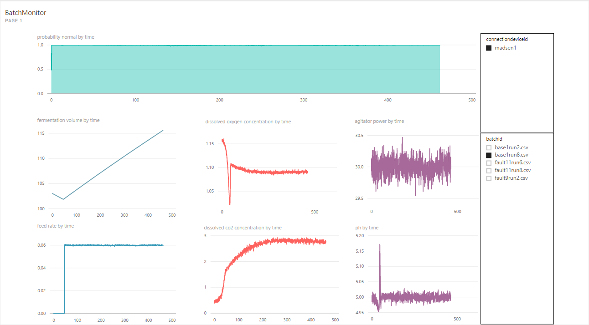
Power BI Dashboard

Slide 18
IIoT Roi Example Components
Cost Estimates
DMI Data Analytics Consultants
Microsoft Azure Subscription
Administration
Network
Enterprise Data and IT Support
Single Device PoC:
2 Weeks
Technical Support
Time-to-Release

Slide 19
Predictive Analytics

Slide 20


Use Case Demo: Improving KPI Outcomes
Penicillin Batch Production

Slide 21
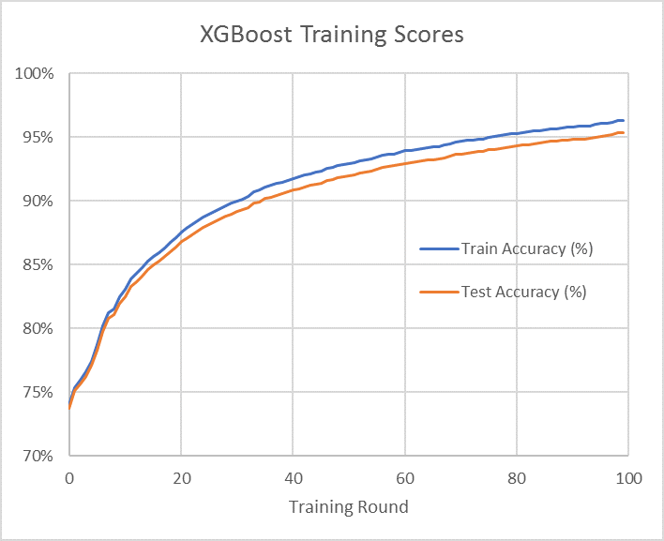
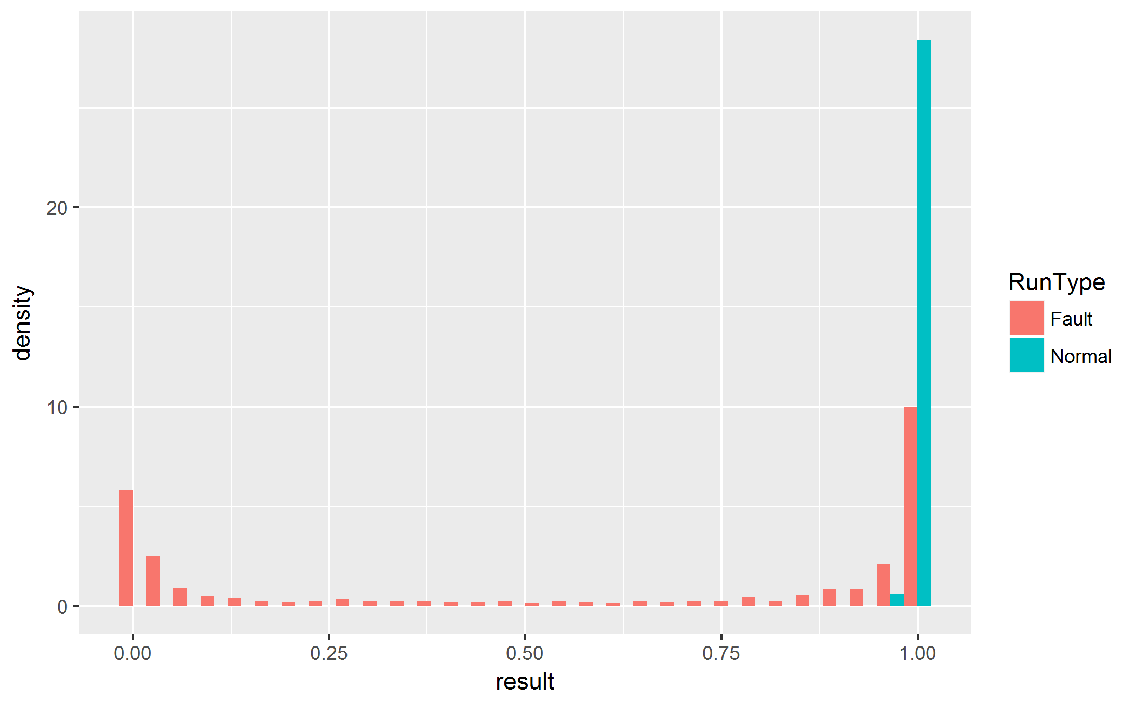


XGBoost Model performance
Get Data →
Predict Fault
Normal = 1
Fault = 0

Slide 22
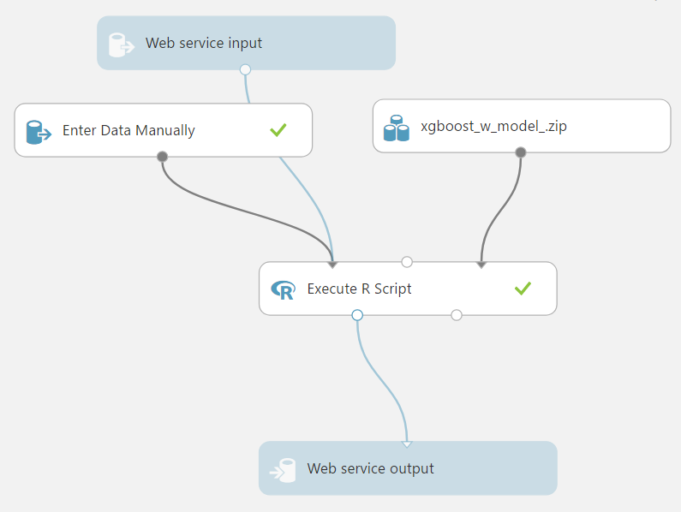

Azure ML Studio Web App

Slide 23
Work Flow Demo
SSL Security from the start
Azure IoT Hub
Azure Stream Analytics
Power BI
Dashboard

Slide 24

Work Flow Demo
Azure Blob Storage
Azure ML Studio
Azure IoT Hub
Azure Stream Analytics
Power BI
Dashboard

Slide 25
Power BI Dashboard

Slide 26
Power BI Dashboard with Predictions

Slide 27
IIoT Roi Example Components
Cost Estimates
DMI Data Analytics Consultants
Microsoft Azure Subscription
Administration
Network
Predictive Model PoC:
2 Weeks
Time-to-Release

Slide 28
Azure Edge Analytics (In Preview)
Azure Blob Storage
Azure ML Studio
Azure
Edge
Gateway
Azure IoT Hub
Azure Stream Analytics
Power BI
Dashboard

Slide 29
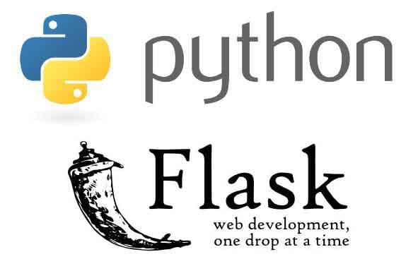
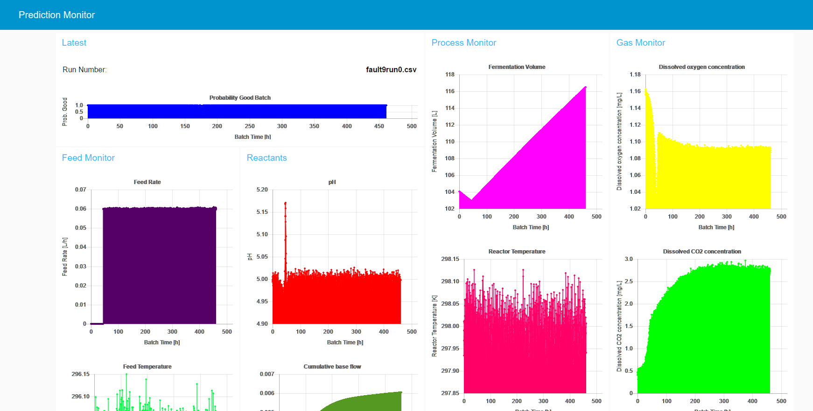
Node-Red Edge Analytics
Localhost
Predictive Analytics
SSL/TLS Security
On-premise IoT Hub
Localhost
Dashboards

Slide 30
IIoT Roi Example Components
Cost Estimates
DMI Data Analytics Consultants
Microsoft Azure Subscription
Administration
Network
Enterprise Data and IT Support
PoC:
4 Weeks
Technical Support
Time-to-Release

Slide 31
HCL Global IoT Report 2017
“What benefits would you expect your organization to see if it were able to increase its utilization of IoT?”
https://www.hcltech.com/iot-survey

Slide 32






QUESTIONS
THINKING AHEAD
Expanded Capabilities
Presentation
Envision
Session
Customer
Immersion
Experience
Strategy
Session

Slide 33
HOW CAN
WE HELP YOU?

Slide 35
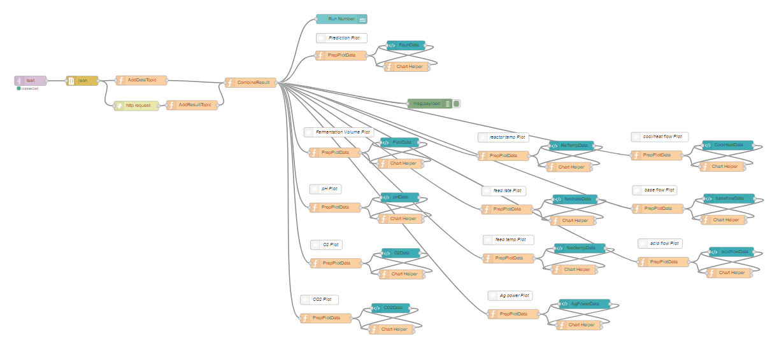
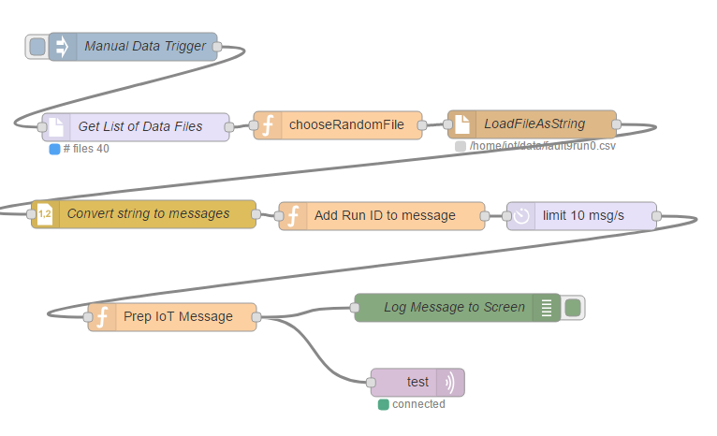
Node-red Edge Analytics
Device
IoT Hub
Dashboard

